Slide 1


Slide 2
React JS – Key Components
Components: Building blocks of React applications that represent reusable UI elements.
JSX: A syntax extension for JavaScript that allows writing HTML-like code within JavaScript.
State: Internal data of a component that can change over time and triggers re-rendering.
Props: Properties passed from parent to child components to share data.
Rendering: The process of generating a React component's view and updating it when the state or props change.
Hooks: Functions that allow using state and other React features in functional components.
Lifecycle Methods: Methods that are invoked at different stages of a component's life, like componentDidMount and componentWillUnmount.
Event Handling: Responding to user interactions like clicks and input changes.
Conditional Rendering: Rendering different components or content based on conditions.
Lists and Keys: Rendering dynamic lists of data and assigning unique keys to optimize rendering performance.
Forms and Controlled Components: Handling form input elements and managing form state.
React Router: Library for implementing client-side routing in a React application.
Context API: Mechanism for sharing data between components without passing props explicitly.
Virtual DOM: An abstraction of the real DOM used by React for efficient updates and rendering.
State Management Libraries: Libraries like Redux and MobX used for managing global application state.
Error Boundaries: Components that catch and handle errors in their child components to prevent application crashes.
Fragment: A special component that allows returning multiple elements without an additional wrapper.
Higher-Order Components (HOC): A pattern to reuse component logic by wrapping components with functions.
React.memo(): A function to memorize functional components and prevent unnecessary re-renders.
Portals: Mechanism to render a component's children to a different DOM node.

Slide 3
React JS – Virtual DOM
The Virtual DOM serves as an intermediary layer between the React components and the actual browser DOM. When a React component's state or props change, React uses the Virtual DOM to efficiently update and render the UI.
Here's how the Virtual DOM works in React:
Initial Render: When a React component is first rendered, it creates a Virtual DOM representation of the component's JSX code. This Virtual DOM is a tree-like structure that represents the desired UI.
Diffing: When a component's state or props change, React re-renders the component and creates a new Virtual DOM representation. It then performs a process called "diffing" to compare the new Virtual DOM with the previous one.
Update: During the diffing process, React identifies the differences between the new and previous Virtual DOMs. It determines the minimal set of changes needed to update the actual DOM to reflect the new UI.
Reconciliation: After identifying the differences, React applies the necessary updates to the actual DOM. It efficiently updates only the specific parts of the DOM that have changed, rather than re-rendering the entire UI.
The use of the Virtual DOM allows React to optimize rendering performance. Instead of directly manipulating the real DOM for every change, React performs updates on the Virtual DOM, which is faster and less resource-intensive. Once the updates are calculated, React applies them to the actual DOM in an optimized manner, minimizing unnecessary re-renders and improving overall efficiency.
By using the Virtual DOM, React abstracts away the complexities of directly interacting with the browser's DOM API and provides a more efficient way to manage and update the UI.

Slide 4
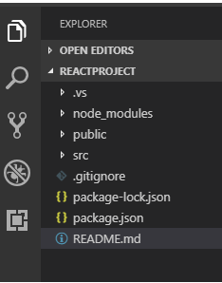
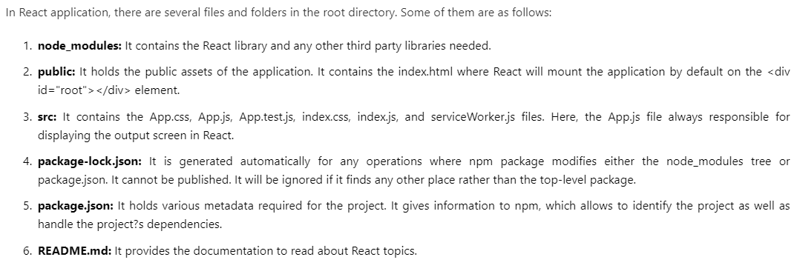
React JS App
7. index.html: This is the main HTML file that serves as the entry point for your React application. It contains the root element where your React components will be rendered. You can also include other static assets like CSS or JavaScript files in this file.
8. index.js: This is the JavaScript file that serves as the entry point for your React application. It is responsible for rendering your React components into the root element specified in the index.html file. It typically imports the main component of your application and uses the ReactDOM.render() method to render it.
9. App.js: This is the main component of your React application. It represents the root component that contains other components and defines the overall structure of your application. It can be considered as the starting point of your application's component hierarchy.
10. App.css: This is a CSS file that contains styles specific to the App component. You can define styles for the elements and components used within the App component in this file.
11. Components: This is a directory where you can create and organize your custom components. Each component is typically defined in its own file within this directory. These components can be reused and composed to build the UI of your application.

Slide 5
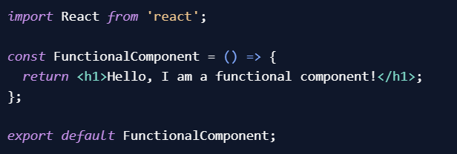
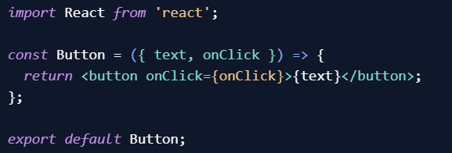
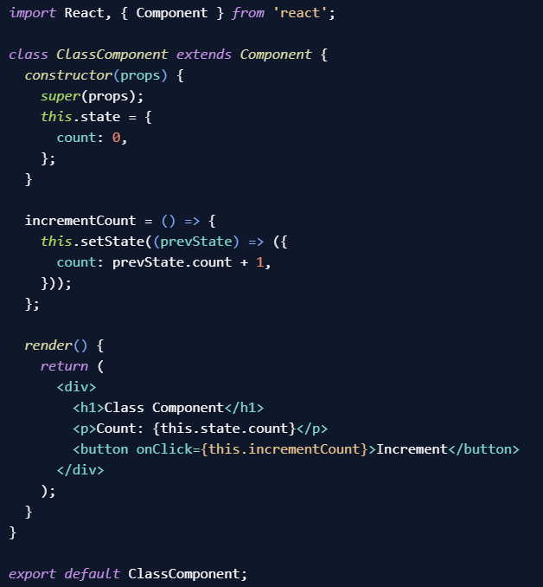
Components
Components are the building blocks of a user interface. They are reusable, self-contained pieces of code that encapsulate a specific functionality or UI element.
React components can be classified into two main types:
Functional components
Class components
Functional Components: Functional components are JavaScript functions that return JSX (JavaScript XML) elements. They are simpler and easier to write compared to class components. They are suitable for simple UI elements or when you don't need to manage state or lifecycle methods.
A functional component can be used for displaying static content or rendering UI elements that don't require state management or complex logic.
For example, a simple button component:
Class Components: Class components are ES6 classes that extend the React.Component class. They have more features and capabilities than functional components, such as state management and lifecycle methods. They provide more flexibility and control over the component's behavior. A class component can be used when you need to manage state or handle complex logic.
In this example, the class component manages the count state and updates it when the button is clicked.

Slide 6
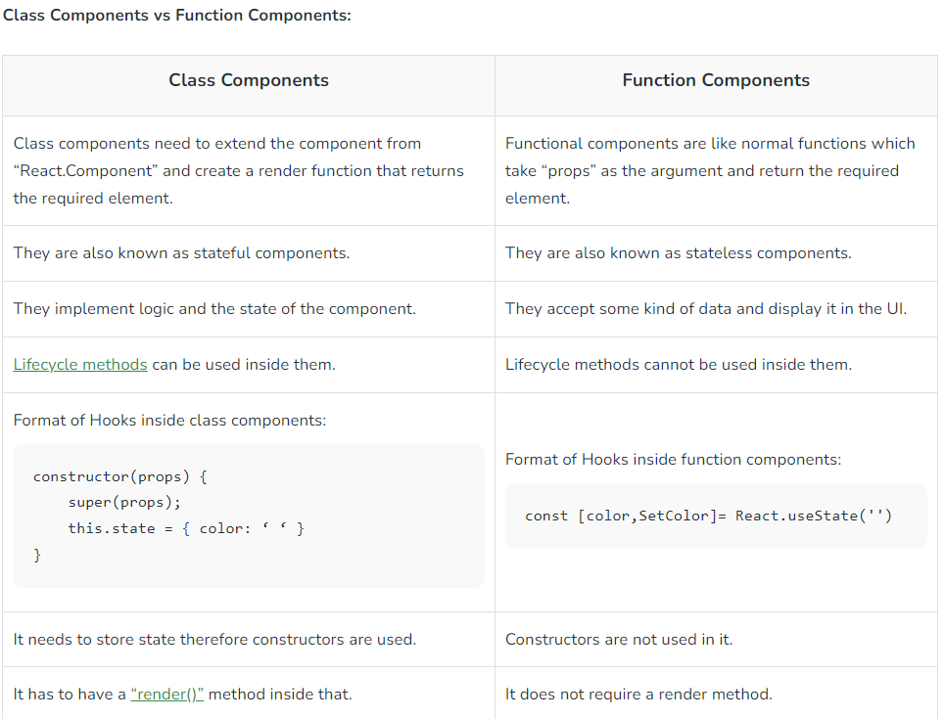
Components

Slide 7
JSX – JavaScript Extension
The render function specifies the HTML output of a React component. JSX(JavaScript Extension), is a React extension which allows writing JavaScript code that looks like HTML. In other words, JSX is an HTML-like syntax used by React that extends ECMAScript so that HTML-like syntax can co-exist with JavaScript/React code. The syntax is used by preprocessors (i.e., transpilers like babel) to transform HTML-like syntax into standard JavaScript objects that a JavaScript engine will parse.
JSX provides you to write HTML/XML-like structures (e.g., DOM-like tree structures) in the same file where you write JavaScript code, then preprocessor will transform these expressions into actual JavaScript code. Just like XML/HTML, JSX tags have a tag name, attributes, and children.
Here are some key aspects of JSX:
HTML-like syntax: JSX looks similar to HTML, allowing you to write tags, attributes, and content in a familiar way. For example, you can write <div>, <h1>, <p>, etc., just like you would in HTML.
Expressions in curly braces: You can embed JavaScript expressions within curly braces {} in JSX. This allows you to dynamically generate content, access variables, and perform calculations. For example, you can write {2 + 2}, {myVariable}, or even call functions within the curly braces.
Component rendering: JSX is used to render React components. You can use component tags just like HTML tags to render components. For example, <MyComponent /> will render the MyComponent component.
Props: JSX allows you to pass data to components using attributes called props. Props are passed as key-value pairs and can be accessed within the component using the props object. For example, <MyComponent name="John" age={25} /> passes the name and age props to the MyComponent component.

Slide 8
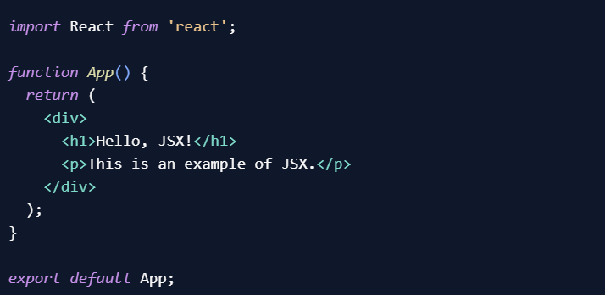
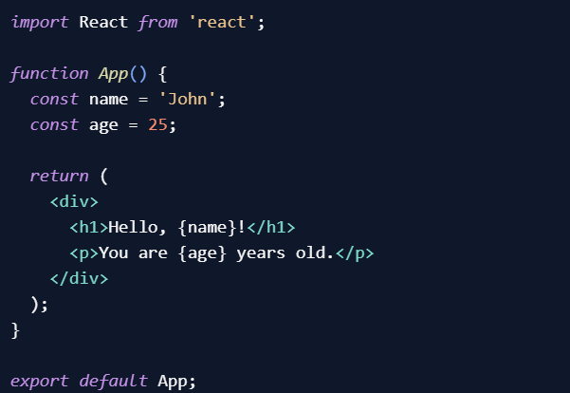
JSX – JavaScript Extension
The render function specifies the HTML output of a React component. JSX(JavaScript Extension), is a React extension which allows writing JavaScript code that looks like HTML. In other words, JSX is an HTML-like syntax used by React that extends ECMAScript so that HTML-like syntax can co-exist with JavaScript/React code. The syntax is used by preprocessors (i.e., transpilers like babel) to transform HTML-like syntax into standard JavaScript objects that a JavaScript engine will parse.
JSX provides you to write HTML/XML-like structures (e.g., DOM-like tree structures) in the same file where you write JavaScript code, then preprocessor will transform these expressions into actual JavaScript code. Just like XML/HTML, JSX tags have a tag name, attributes, and children.
Here are some key aspects of JSX:
HTML-like syntax: JSX looks like HTML, allowing you to write tags, attributes, and content in a familiar way. For example, you can write <div>, <h1>, <p>, etc., just like you would in HTML.
In this example, we use JSX to define a component called App. It renders a <div> element containing an <h1> heading and a <p> paragraph. This JSX code looks like HTML but is JavaScript.
Expressions in curly braces: You can embed JavaScript expressions within curly braces {} in JSX. This allows you to dynamically generate content, access variables, and perform calculations. For example, you can write {2 + 2}, {myVariable}, or even call functions within the curly braces.
In this example, we use JSX to dynamically display the values of the name and age variables. The expressions {name} and {age} are enclosed in curly braces within the JSX code. The values of the variables will be evaluated and displayed in the rendered output.

Slide 9
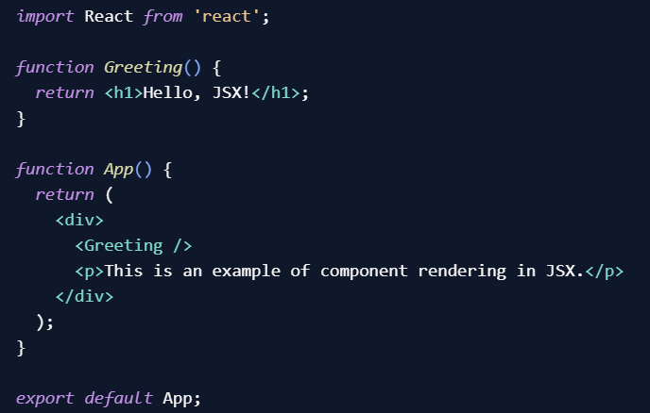
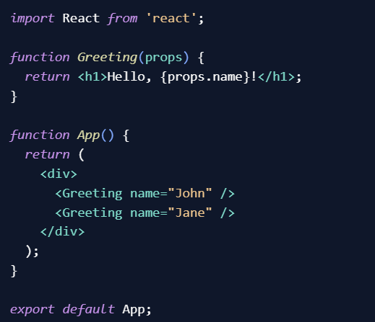
JSX – JavaScript Extension
Component rendering: JSX is used to render React components. You can use component tags just like HTML tags to render components. For example, <MyComponent /> will render the MyComponent component.
In this example, we define a component called Greeting that renders an <h1> heading. We then use JSX to render the Greeting component within the App component. The JSX code <Greeting /> is equivalent to calling the Greeting component and rendering its output
Props: JSX allows you to pass data to components using attributes called props. Props are passed as key-value pairs and can be accessed within the component using the props object. For example, <MyComponent name="John" age={25} /> passes the name and age props to the MyComponent component
In this example, we define a component called Greeting that accepts a prop called name. The Greeting component displays a personalized greeting using the name prop.

Slide 10
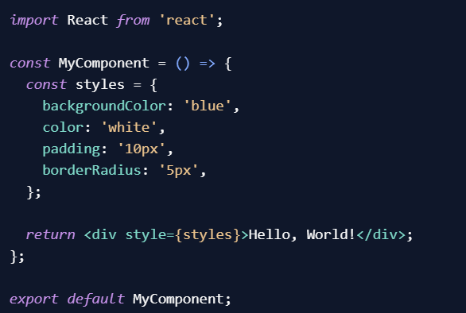
Styling
Styling in ReactJS refers to the process of applying visual styles to the components of a React application.
There are several ways to style React components:
Inline Styles:
Inline styles allow you to define styles directly within the JSX code of a component.
You can use JavaScript objects to specify the styles, where the keys represent the CSS properties, and the values represent the corresponding values
In the above example, the styles object defines the background color, text color, padding, and border radius for the div element. The style prop is used to apply these styles to the component.

Slide 11
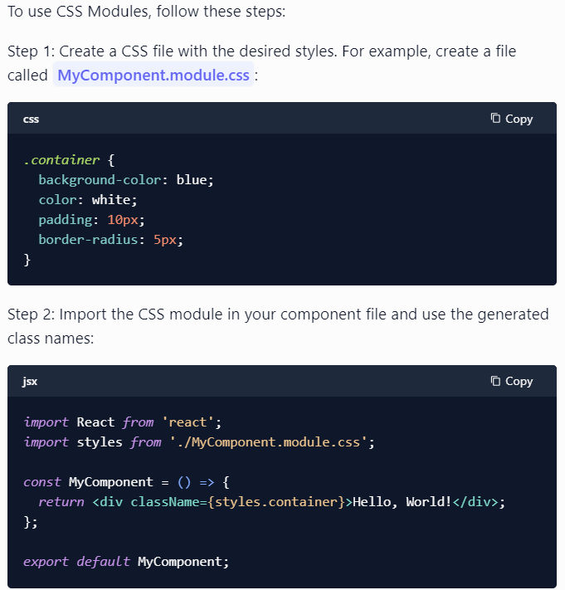
Styling
CSS Modules:
CSS Modules is an approach that allows you to write CSS stylesheets that are scoped to a specific component. This means that the styles defined in one component will not affect the styles of other components. CSS Modules use a naming convention to generate unique class names for each component.
In the above example, the styles object is imported from the CSS module file MyComponent.module.css. The container class is defined in the CSS module and applied to the div element using the className prop.

Slide 12
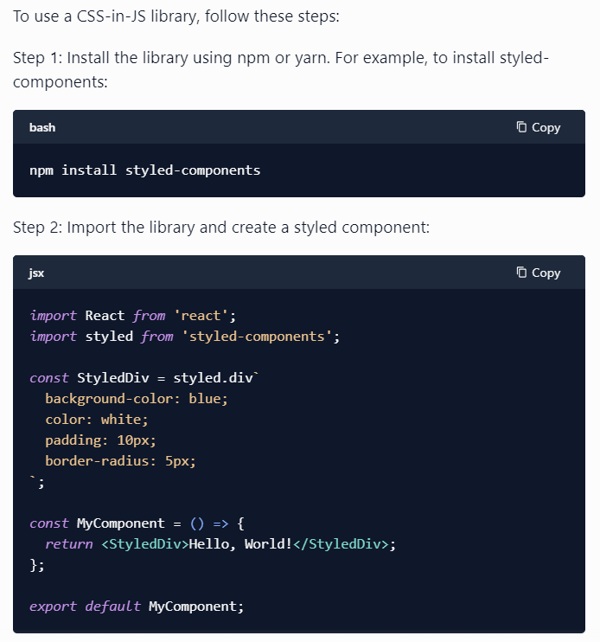
Styling
CSS-in-JS Libraries:
CSS-in-JS libraries, such as styled-components or Emotion, allow you to write CSS styles directly in your JavaScript code. These libraries provide a way to define reusable styled components that encapsulate both the styles and the component logic
In the above example, the styled function from the styled-components library is used to create a new styled component called StyledDiv. The CSS styles are defined using a template literal syntax. The StyledDiv component can then be used in the same way as any other React component

Slide 13
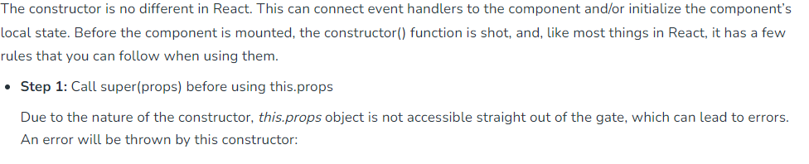
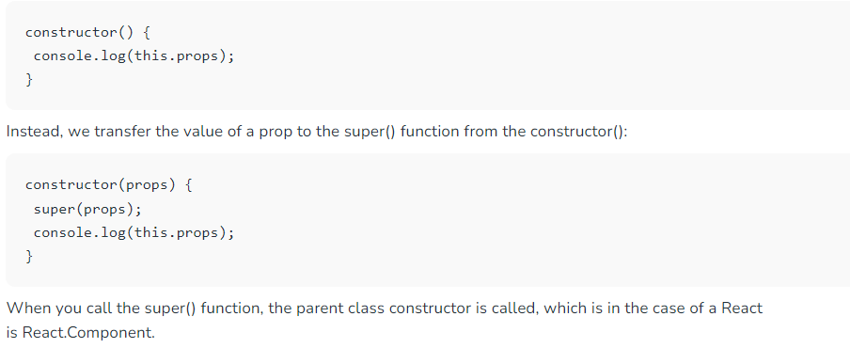
Constructor
A constructor is a special method that is called when an instance of a component is being created and initialized. It is used to set up the initial state and bind event handlers. The constructor is defined using the constructor() method.
The concept of a constructor is the same in React. The constructor in a React component is called before the component is mounted. When you implement the constructor for a React component, you need to call super(props) method before any other statement. If you do not call super(props) method, this.props will be undefined in the constructor and can lead to bugs.

Slide 14
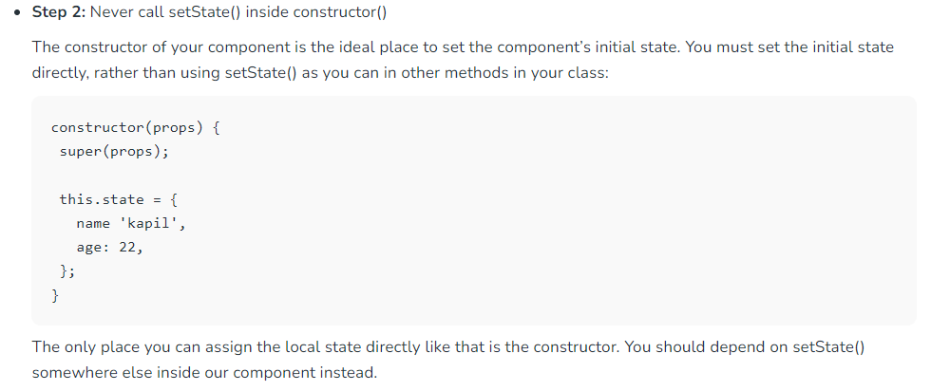
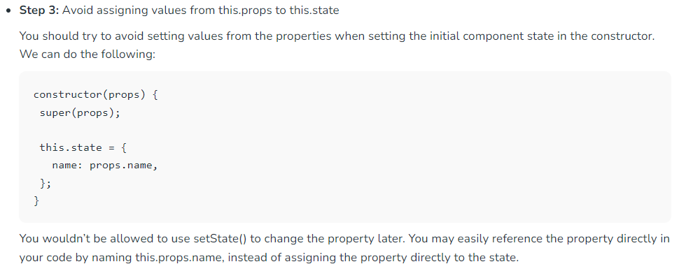
Constructor
React components have a method available to them called setState Calling "this.setState" causes React to re-render your application and update the DOM.
The issue with doing this is that the constructor is only ever called once in the life cycle of the component. Since the props can change many times during that lifecycle, that implication is broken.

Slide 15
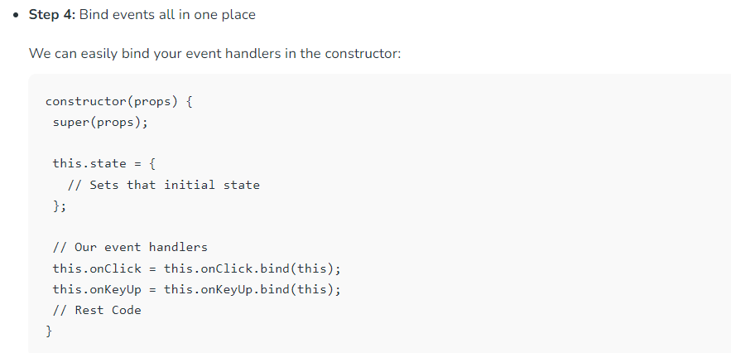
Constructor

Slide 16
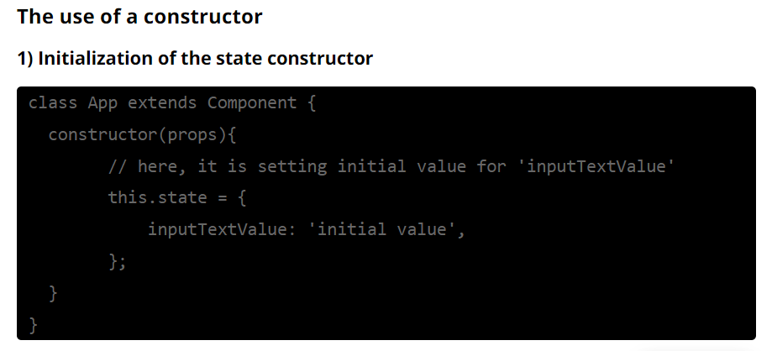
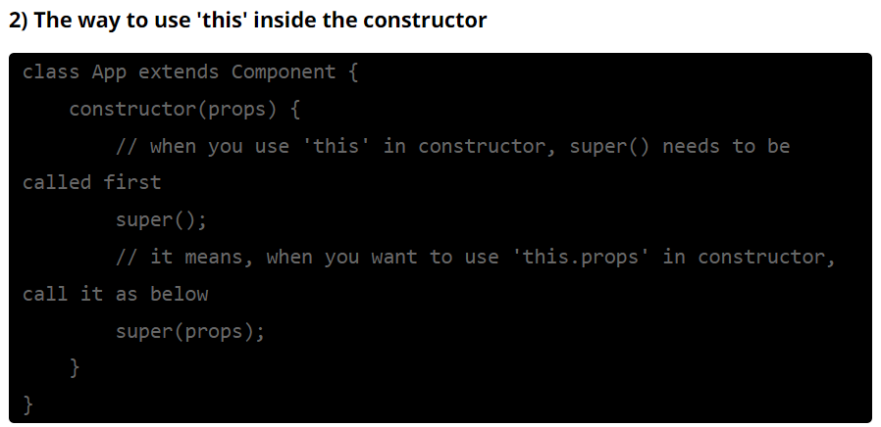
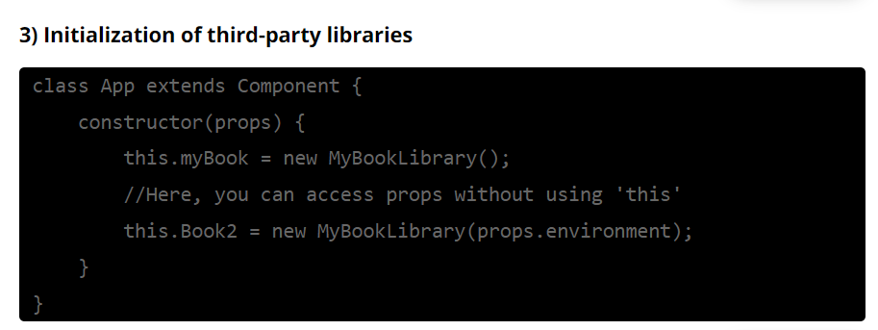
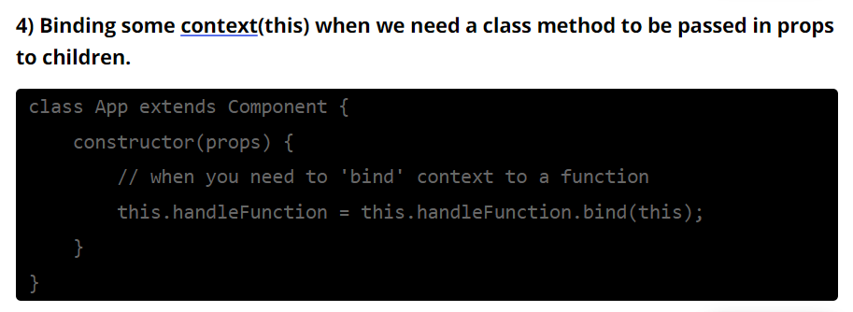
Constructor

Slide 17
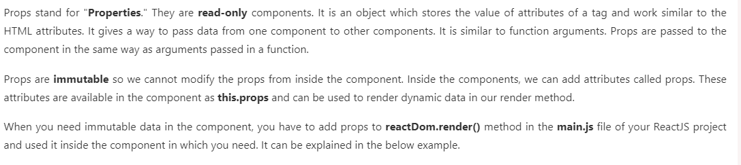
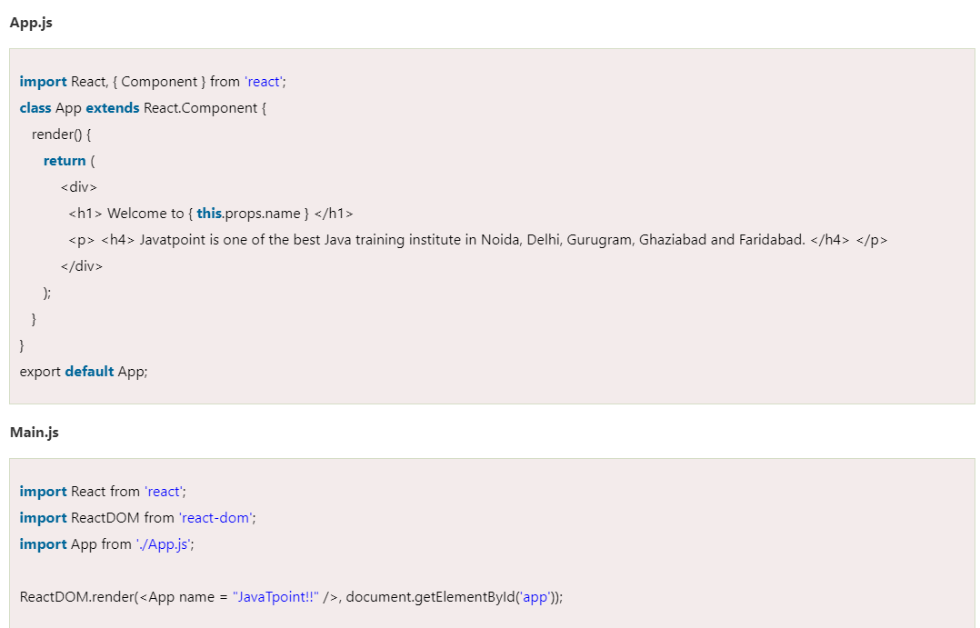
Props

Slide 18
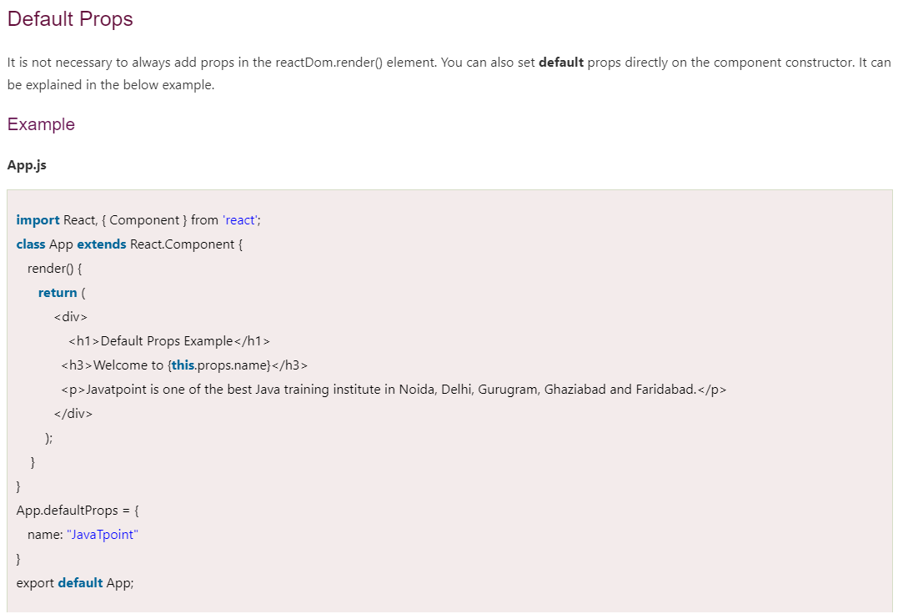
Props

Slide 19
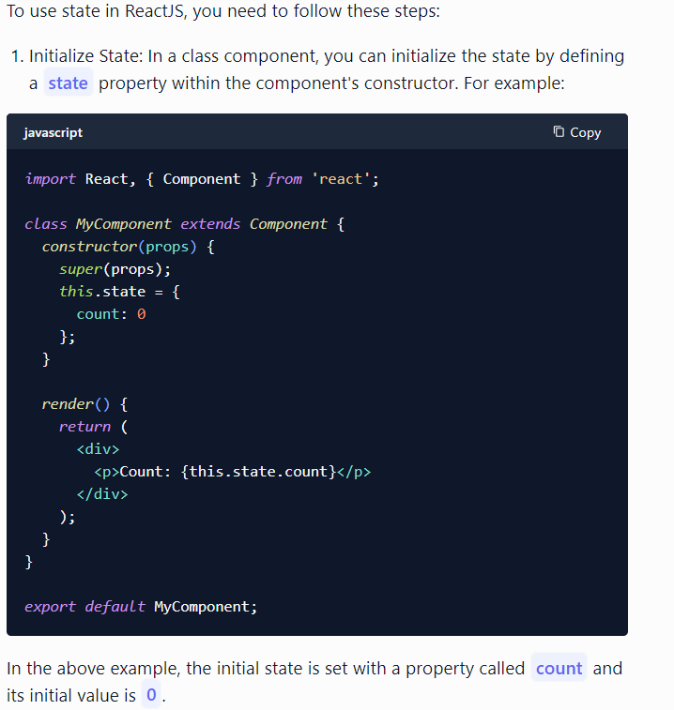
State
State is a built-in feature that allows you to manage and store data within a component. It represents the current state of the component and can be updated over time, triggering re-rendering of the component and its child components.
State is typically used to store and manage data that can change during the lifetime of a component, such as user input, API responses, or any other dynamic data. It provides a way to keep track of the component's internal data and reflect those changes in the user interface.

Slide 20
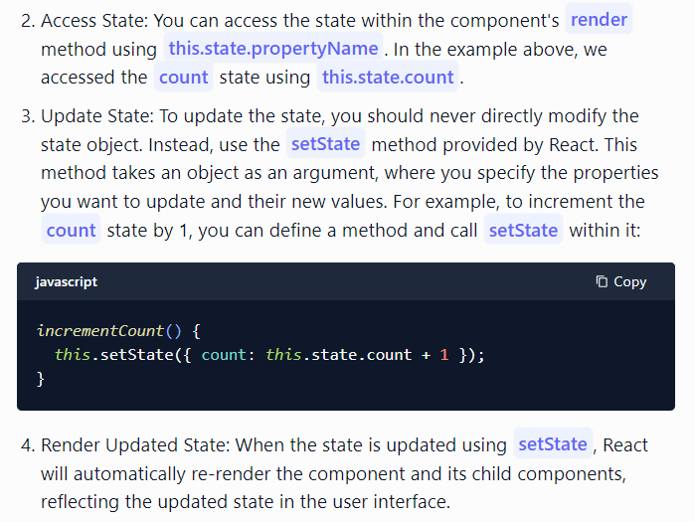
State

Slide 21
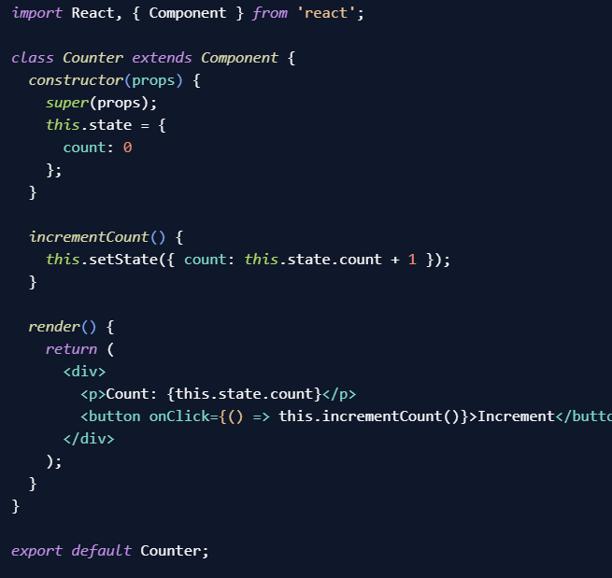
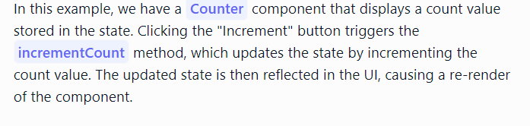
State

Slide 22
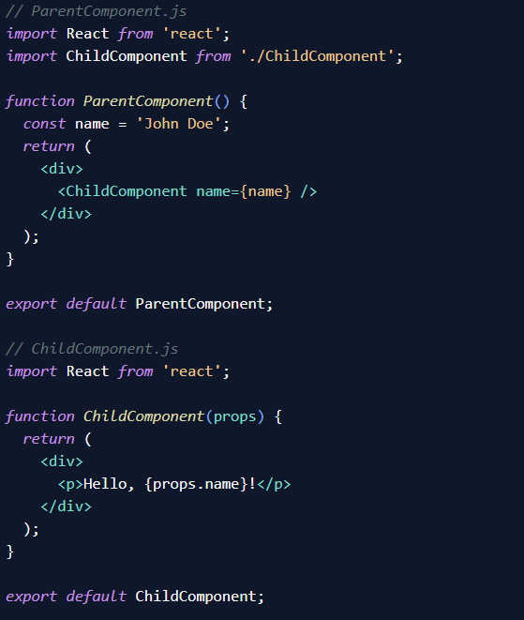
Prop vs State
Props:
Props (short for properties) are used to pass data from a parent component to its child component(s).
Props are read-only and cannot be modified by the child component.
Props are passed down the component tree in a unidirectional flow, from parent to child.
Props are defined by the parent component when rendering the child component.
Props are accessed within the child component using this.props in class components or as a parameter in functional components.
Props are useful for passing data and behavior to child components, allowing for reusable and modular code.
In this example, the ParentComponent passes the name prop to the ChildComponent. The ChildComponent receives the prop as an argument and displays it in the UI.

Slide 23
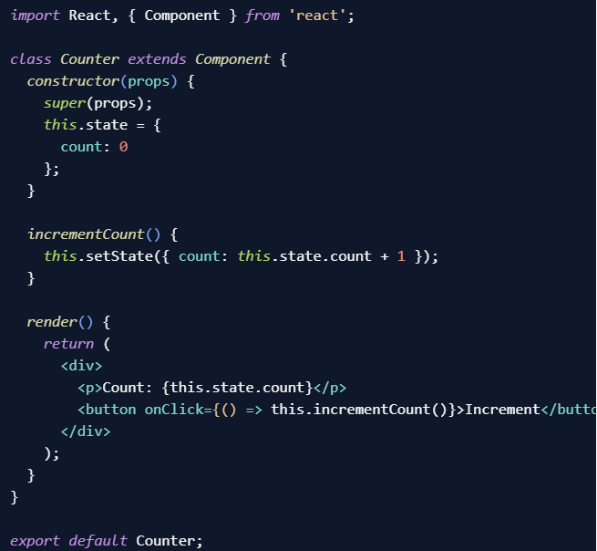
Prop vs State
State:
State is used to manage and store data within a component.
State is mutable and can be updated using the setState method provided by React.
State is internal to a component and can only be accessed and modified by that component.
State is typically used for data that can change over time, such as user input, API responses, or any other dynamic data.
State is initialized within the component's constructor or using hooks in functional components.
State updates trigger a re-render of the component and its child components.
In this example, the Counter component manages the count state. Clicking the "Increment" button triggers the incrementCount method, which updates the state by incrementing the count value. The updated state is then reflected in the UI.

Slide 24
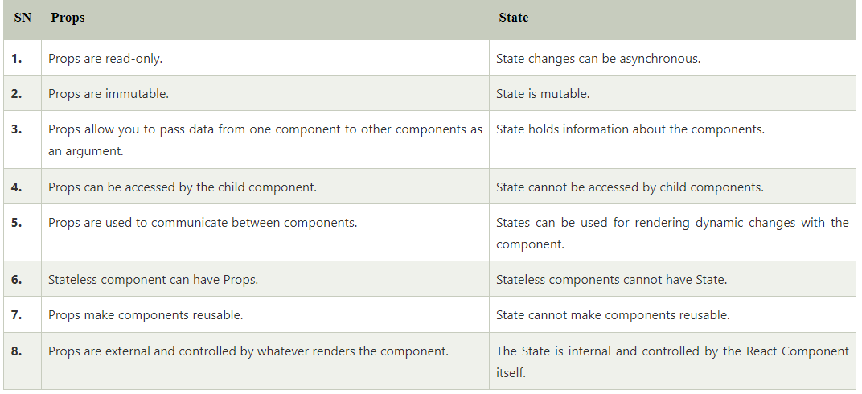
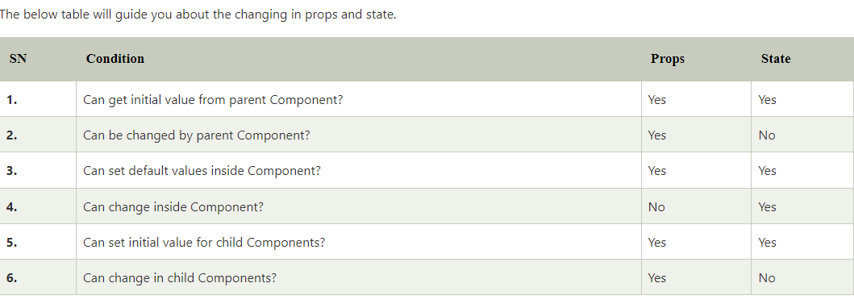
Prop vs State

Slide 25
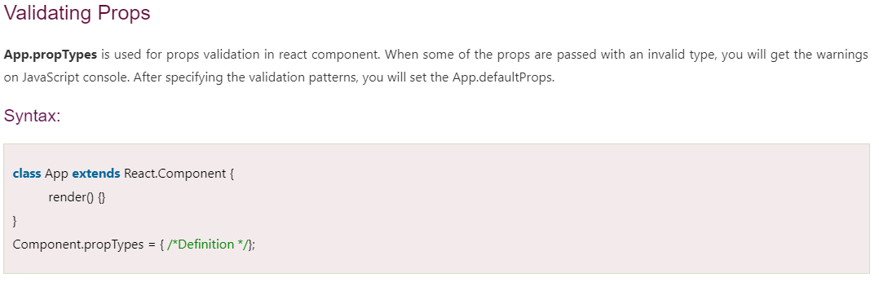
Prop Validation
Props are an important mechanism for passing the read-only attributes to React components. The props are usually required to use correctly in the component. If it is not used correctly, the components may not behave as expected. Hence, it is required to use props validation in improving react components.
Props validation is a tool that will help the developers to avoid future bugs and problems. It is a useful way to force the correct usage of your components. It makes your code more readable. React components used special property PropTypes that help you to catch bugs by validating data types of values passed through props, although it is not necessary to define components with propTypes. However, if you use propTypes with your components, it helps you to avoid unexpected bugs.

Slide 26
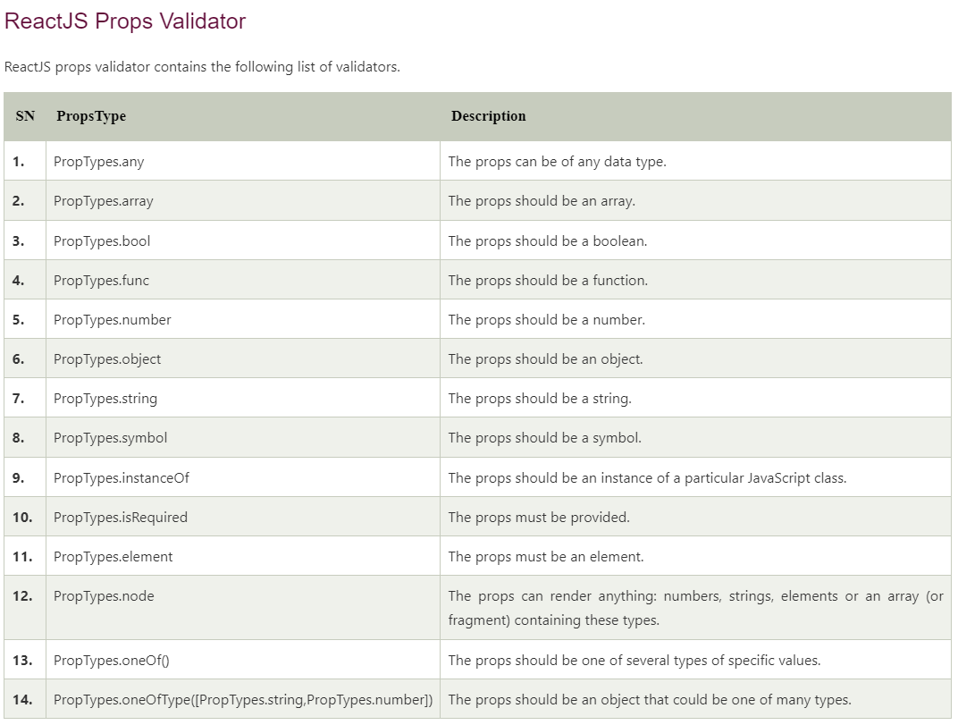
Prop Validation

Slide 27
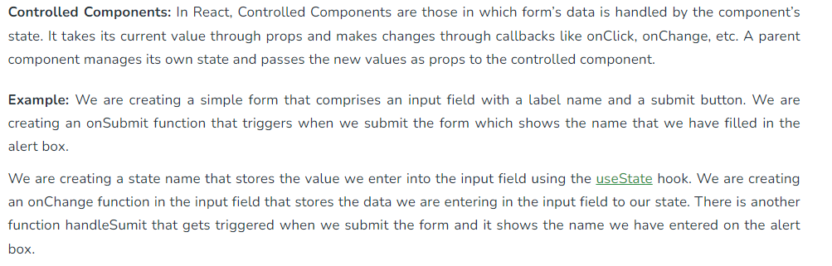
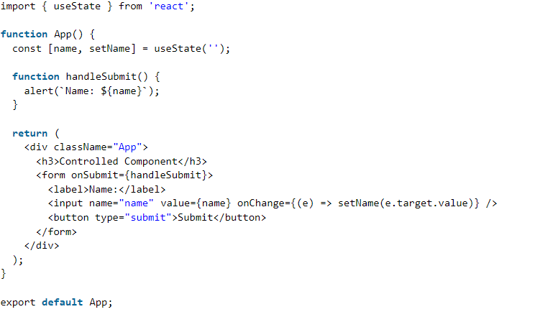
Component – Controlled vs Uncontrolled

Slide 28
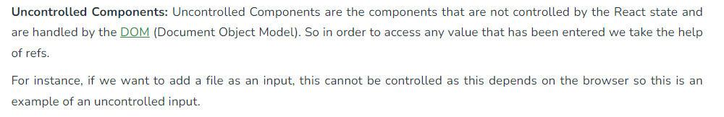
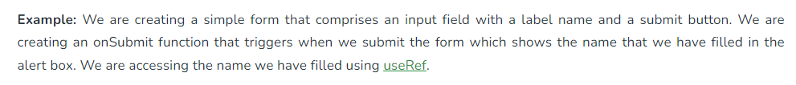
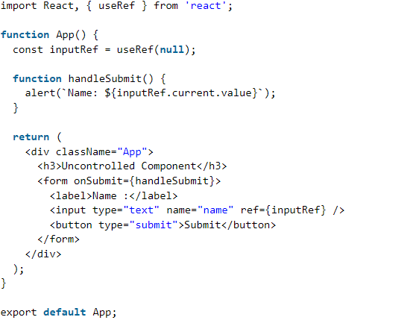
Component – Controlled vs Uncontrolled

Slide 29
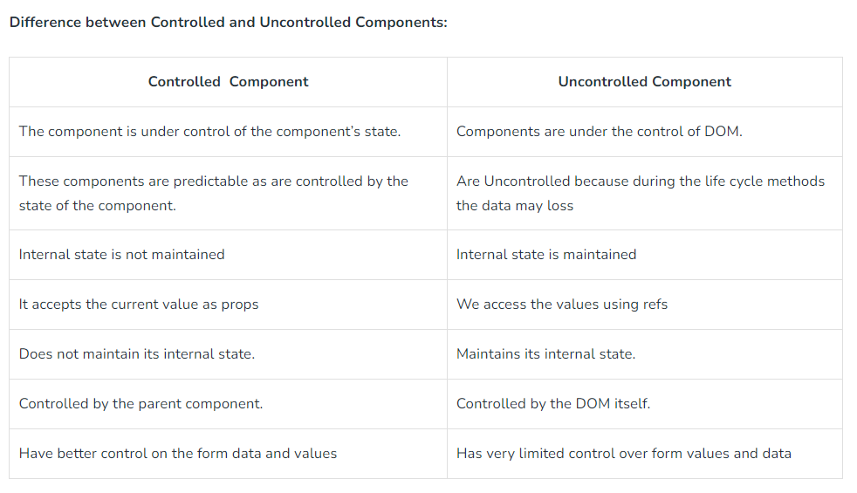
Component – Controlled vs Uncontrolled

Slide 30
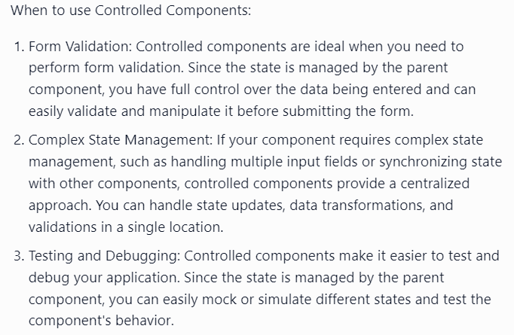
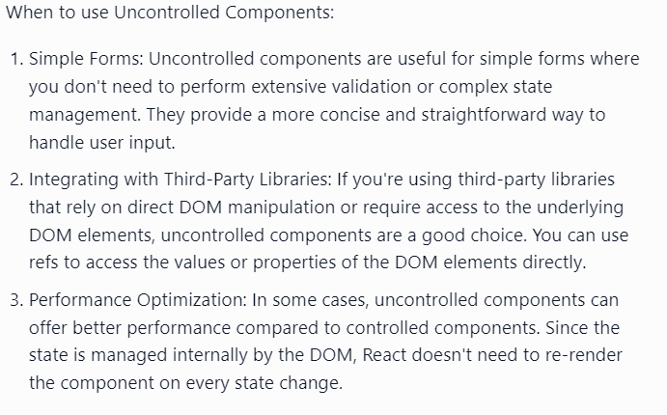
Component – Controlled vs Uncontrolled

Slide 31
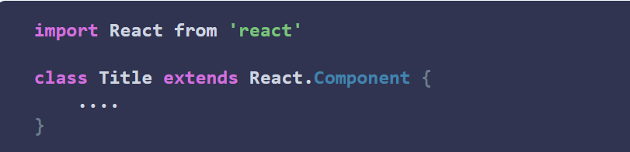
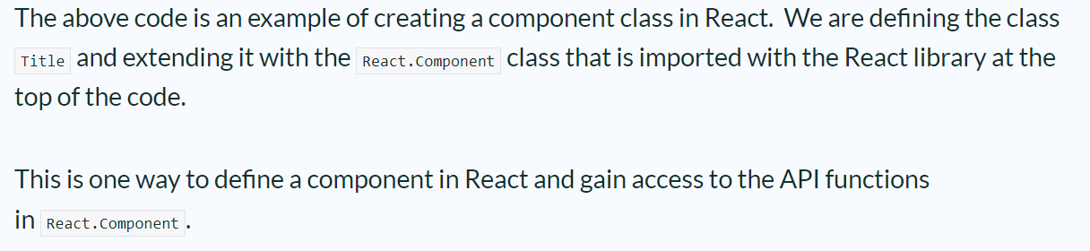
Component API
ReactJS component is a top-level API. It makes the code completely individual and reusable in the application. Component API refers to the set of methods and properties that are available to create and manage components.
It includes various methods for:
The React Component API allows users to access functions for:
State changes
Lifecycle stages
Rendering

Slide 32
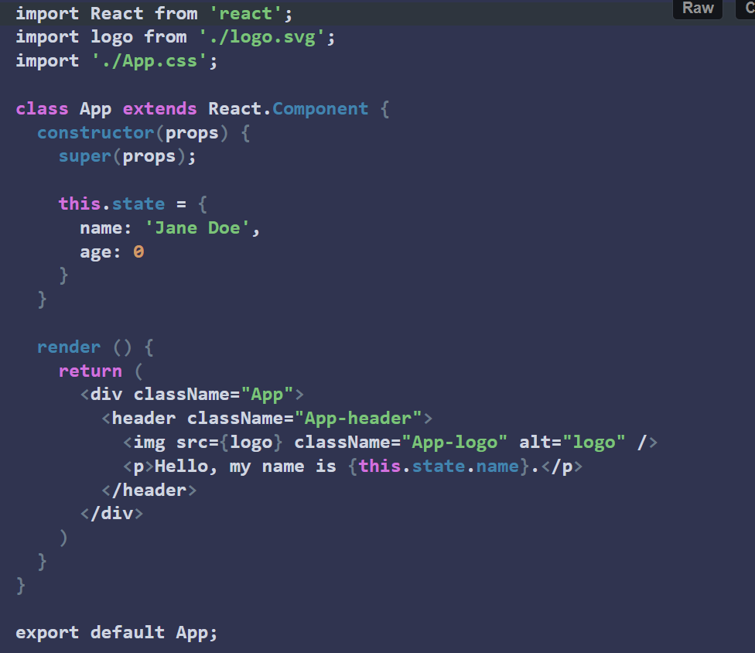
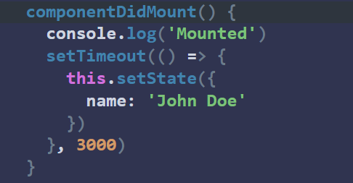
Component API
The function call names provide hints as to when they are called in the component lifecycle. When a component is added to the DOM, it has “mounted”. When it is removed the DOM, it is “unmounted”. A component updates when it’s props or state change.
Function componentDidMount is called immediately after the component is added to the tree (DOM). This makes it a good place to make HTTP calls to APIs to retrieve data.
The component:
Mounts with the name ‘Jane Doe’
Runs the componentDidMount function
Updates the state
Renders the new name value to display ‘John Doe’

Slide 33
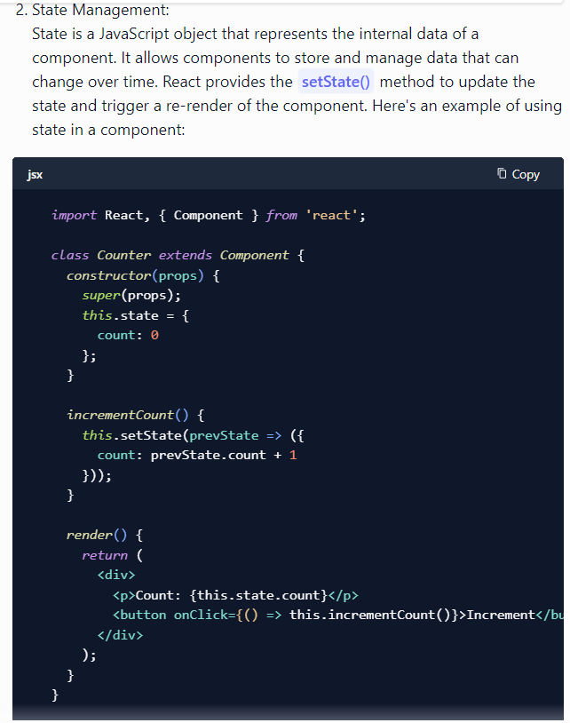
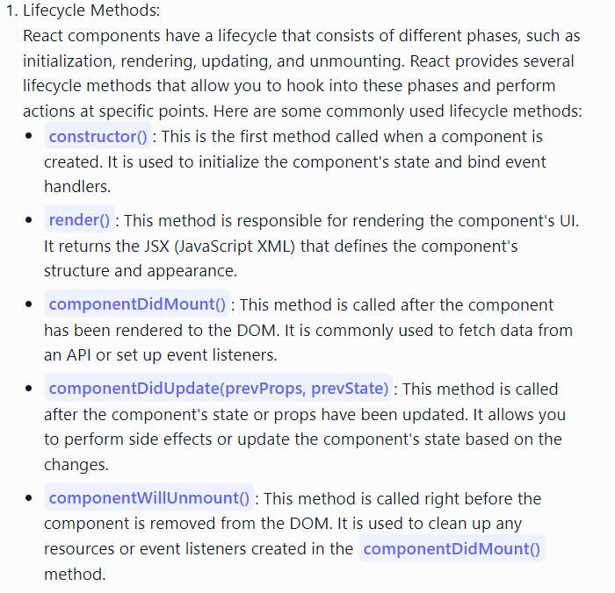
Component API
The Component API in ReactJS consists of two main parts: lifecycle methods and state management.

Slide 34
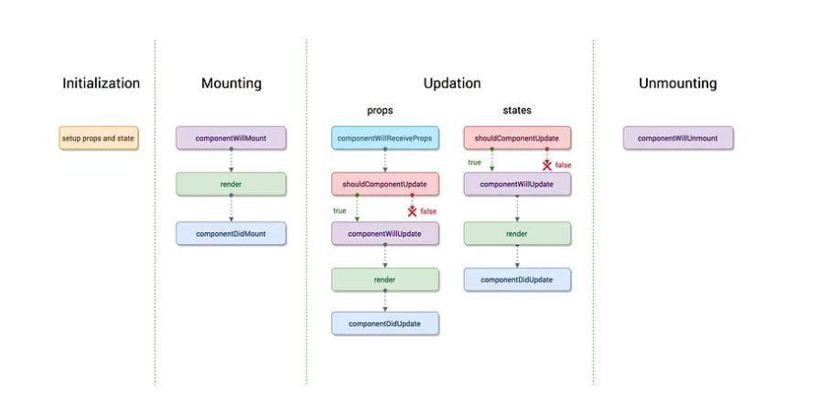
Component Life Cycle

Slide 35


Component Life Cycle

Slide 36

Passing Data between parent and child components

Slide 37

Passing Data between parent and child components

Slide 38

Passing Data between parent and child components
While props are great for passing data from a parent component to a child component, there are certain situations where you may want to share data across multiple components without passing props down the component tree. This is where the Context API and state come into play.
The Context API is a way to share data between components without passing props manually down the component tree. It allows you to create a shared context that can be accessed by any component in the tree, without having to pass props through intermediate components.

Slide 39

Passing Data between parent and child components
The State is another way to store and manage data within a component. It is similar to props, but the difference is that state is mutable, meaning you can change its value within the component, while props are read-only and can only be passed down from a parent component.

Slide 40
Form Handling
Just like in HTML, React uses forms to allow users to interact with the web page.
Handling forms is about how you handle the data when it changes value or gets submitted. In HTML, form data is usually handled by the DOM. In React, form data is usually handled by the components. When the data is handled by the components, all the data is stored in the component state. You can control changes by adding event handlers in the onChange attribute. We can use the useState Hook to keep track of each inputs value and provide a "single source of truth" for the entire application.
In React, there are two ways of handling form data:
Controlled Components: In this approach, form data is handled by React by using hooks such as the useState hook.
Uncontrolled Components: Form data is handled by the Document Object Model (DOM) rather than by React. The DOM maintains the state of form data and updates it based on user input.
To better understand the difference between controlled and uncontrolled components, consider there are two ways of riding a bike.
In the first approach, you let the bike take control. You sit on the bike and let it decide the direction and speed. You might try to make it go in a certain direction by leaning your body, but ultimately, the bike decides where to go.
This is like uncontrolled components in React. You place a form element in the component, and the DOM takes control of it. The DOM decides the state of the input element and updates it based on a user's input.
In the second approach, you take control of the bike. You hold the handlebars and pedal, and you decide where to go and how fast to ride. You can easily slow down or speed up as needed.
This is like controlled components where a React component takes control of the form data and maintains the state of form elements. The component decides when and how to update the state, and its re-renders itself based on the state changes.

Slide 41

Form Handling
Controlled Components in React:
In React, a controlled component is a component where form elements derive their value from a React state.
When a component is controlled, the value of form elements is stored in a state, and any changes made to the value are immediately reflected in the state.
To create a controlled component, you need to use the value prop to set the value of form elements and the onChange event to handle changes made to the value.
The value prop sets the initial value of a form element, while the onChange event is triggered whenever the value of a form element changes. Inside the onChange event, you need to update the state with the new value using a state update function.
The useState hook defines a state variable (inputValue) and a state update function (setInputValue).
The value prop sets the initial value of the input element to the value of inputValue.
Also, the onChange event handles changes made to the input value. The handleChange function updates the inputValue state with the new value of the input element, and the updated value is immediately reflected in the state and displayed on the screen.
As the user types into the input field, the handleChange function updates the state variable using the "setInputValue" function. The component is then re-rendered, and the input field's value attribute is updated to reflect the new value of inputValue.
The value of the input field and the text displayed below it are always in sync, making it a controlled component.

Slide 42


Form Handling
Handle dropdowns and checkboxes in Controlled Components:
Just like with input elements, the value of a dropdown can be set by using the value prop in conjunction with the onChange event handler to update the state of the component.
For example, to handle a dropdown menu, you can define the initial value of the dropdown menu within the state of the component, then update the state when the value of the dropdown changes or can handle checkboxes:

Slide 43

Form Handling – Multiple form elements
When working with forms in React, it's common to have several form elements, such as text inputs, checkboxes, radio buttons, and others. To manage the state of these form elements, you can define the values for the input fields as an object using a single state variable and update each respective state variable using the onChange event.
As an example, suppose you wish to create a form with the following fields:
Text input for the user's name
An email field for the user's email
A textarea field for the user's message
The useState hook defines a state object named formData that contains three properties: name, email, and message, each initialized to an empty string.
The handleChange function is called whenever a user types in one of the form fields. It extracts the name and value of the form field that has changed using the event.target object and then updates the formData state variable using the setFormData function.
The setFormData function uses the spread operator (...) to copy the previous formData object. Then it updates the value of the changed form field by setting its value prop with the new value.
By using an object to manage form data, we can easily keep track of the values of multiple form elements. This makes it easier to manage and manipulate the state of our form data, especially when dealing with complex forms with many form elements.

Slide 44


Events
Every modern webpage that we create today tend to have user interactions. When the user interacts with the web application events are fired. That event can be a mouse click, a keypress etc..
From the developer side, we need to ‘listen’ to such events and then make our application respond accordingly. This is called event handling that provides a dynamic interface to a webpage. Like JavaScript DOM, React also provides us some built-in methods to create a listener that responds accordingly to a specific event.
Now we will look at certain rules to keep in mind while creating events in React.
camelCase Convention: Instead of using lowercase we use camelCase while giving names of the react events. That simply means we write ‘onClick’ instead of ‘onclick’.
Pass the event as a function: In React we pass a function enclosed by curly brackets as the event listener or event handler, unlike HTML where we pass the event handler or event listener as a string.
Prevent the default: Just returning false inside the JSX element does not prevent the default behavior in react. Instead, we must call the ‘preventDefault’ method directly inside the event handler function.
Now after watching the above syntax, a question must come in, that what is the ‘e’ object, and from where does it come from. ‘e’ is a synthetic event. This is an object made with a wrapper around the actual event of the browser. This object is cross-browser.

Slide 45





Events
Events are the things that JavaScript can react to. Event handling in React is quite like DOM element event handling. The following are some specific events in React that you could encounter when interacting with websites built with React:
Clicking an element
Submitting a form
Scrolling page
Hovering an element
Loading a webpage
Input field change
User stroking a key
Image loading

Slide 46



Events

Slide 47
Events

Slide 48

Events

Slide 49




Events

Slide 50


Binding Event Handler

Slide 51


Binding Event Handler

Slide 52
Conditional Rendering
You can build Single Page Applications (SPA) that are dynamic and highly interactive with React. One feature that allows for this is conditional rendering.
Conditional rendering is a term to describe the ability to render different user interface (UI) markup if a condition is true or false. In React, it allows us to render different elements or components based on a condition. This concept is applied often in the following scenarios:
Rendering external data from an API.
Showing or hiding elements.
Toggling application functionality.
Implementing permission levels.
Handling authentication and authorization.
In React, you can conditionally render JSX using JavaScript syntax like if statements, &&, and ? : operators.
One of the essential features in modern React applications is the dynamic rendering of User Interface (UI) components with JSX based on user interactions, which cause certain events to be triggered and specific actions to be performed. These events are typically defined in functional components while building the application and are carried out by "Conditional Rendering."

Slide 53





Conditional Rendering

Slide 54


Conditional Rendering

Slide 55

Conditional Rendering

Slide 56


Conditional Rendering

Slide 57

Conditional Rendering

Slide 58



List

Slide 59



List
The above warning message says that each of the list items in our unordered list should have a unique key. A “key” is a special string attribute you need to include when creating lists of elements in React

Slide 60


List

Slide 61



Keys

Slide 62




Keys

Slide 63


Keys

Slide 64



Keys

Slide 65



Refs

Slide 66



Refs

Slide 67


Refs

Slide 68


Refs

Slide 69


Refs

Slide 70

Refs

Slide 71


ReactJS Fragments
React is a powerful library that uses the components formed earlier and reuses those components when required. Before React v16, whenever there was a need to return a group of components/elements, we needed to wrap our elements in an enclosing <div>. React didn't have any abilities to circumvent this, so that means any component of yours with multiple children would always require a wrapper, and due to this, an additional node is required in DOM. This does not significantly affect a small React application, but working on a real-life project with multiple layers of nested children can largely affect the application's response time
Before React version 16.2 was released, whenever we needed to return multiple elements, they had to be wrapped in a single div. In most cases, the wrapper div is “irrelevant” and is only used because React components can return only one element at a time. This behavior leads to several problems, including useless markup and sometimes even invalid HTML to be rendered, which is often troublesome.
This is where the Fragments API comes in.
“ Fragments are syntax that allows us to add multiple elements to a React component without wrapping them in an extra DOM node.”

Slide 72







ReactJS Fragments

Slide 73

ReactJS Fragments

Slide 74

ReactJS Fragments

Slide 75



ReactJS Fragments – Use Cases

Slide 76




ReactJS Fragments – Use Cases

Slide 77

ReactJS Fragments

Slide 78



Styling using CSS - Inline
CSS in React is used to style the React App or Component. The style attribute is the most used attribute for styling in React applications, which adds dynamically-computed styles at render time. It accepts a JavaScript object in camelCased properties rather than a CSS string.

Slide 79






Styling using CSS - Inline

Slide 80





Styling using CSS - Stylesheets

Slide 81




Styling using CSS - Modules
When you build your app, webpack will automatically look for CSS files that have the .module.css name. Webpack will take those class names and map them to a new, generated localized name.
If you inspect the blue paragraph, you’ll see that the element class is transformed into _src_App_module__BlueParagraph.

Slide 82




Styling using CSS – JS Libraries
In order to use Styled components, we need to install styled components by executing the following command:
npm install styled-components

Slide 83







Styling using CSS

Slide 84




Error Handling - Error Boundaries
It’s important to note that error boundaries catch errors during rendering, in lifecycle methods, and constructors of the whole tree below them. However, error boundaries do not catch errors for:

Slide 85




Error Handling - Error Boundaries

Slide 86


Error Handling - Error Boundaries

Slide 87




Error Handling - Error Boundaries

Slide 88




Error Handling - Error Boundaries

Slide 89





Error Handling - Error Boundaries

Slide 90



React - Redux

Slide 91




React - Redux
The data in React always flows from parent to child components which makes it unidirectional. This surely keeps our data organized and helps us in controlling the application better. Because of this, the application’s state is contained in specific stores and as a result, the rest of the components remain loosely coupled. This makes our application more flexible leading to increased efficiency. That’s why communication from a parent component to a child component is convenient.
But what happens when we try to communicate from a non-parent component?
A child component can never pass data back up to the parent component. React does not provide any way for direct component-to-component communication. Even though React has features to support this approach, it is a poor practice. It is prone to errors and leads to spaghetti code. So, how can two non-parent components pass data to each other?
Thus, with Redux, it becomes clear where the components get their state from as well as where should they send their states to. Now the component initiating the change does not have to worry about the list of components needing the state change and can simply dispatch the change to the store. This is how Redux makes the data flow easier.

Slide 92


React - Redux
Just like React, Redux is also a library which is used widely for front-end development. It is basically a tool for managing both data-state and UI-state in JavaScript applications. Redux separates the application data and business logic into its own container in order to let React manage just the view. Rather than a traditional library or a framework, it’s an application data-flow architecture. It is most compatible with Single Page Applications (SPAs) where the management of the states over time can get complex

Slide 93


React – Components of Redux

Slide 94




React –Redux
Let’s understand with Simple Counter app that increments and decrements the state. The state will be an integer.
Install Redux by executing the below command:
The final directory structure should look like this

Slide 95



React –Redux

Slide 96




React Router

Slide 97



React Router

Slide 98


React Router

Slide 99




React Router

Slide 100





React Router

Slide 101


React – Map

Slide 102



React – Map

Slide 103




React – Map

Slide 104


React – Table

Slide 105


React – Table

Slide 106


React – Table

Slide 107




React – Context API

Slide 108



React – Context API

Slide 109


React – Context API

Slide 110




React – Context API
Redux

Slide 111


React – Context API

Slide 112




React – Context API

Slide 113




React – Context API

Slide 114



React – Context API

Slide 115


React – Context API

Slide 116


React – Hooks

Slide 117





React – useState hook

Slide 118


React – useEffect hook

Slide 119


React – useEffect hook

Slide 120



React – useEffect hook

Slide 121



React – useEffect hook

Slide 122




React – useEffect hook

Slide 123





React – useEffect hook

Slide 124



React – useEffect hook

Slide 125


React – Hooks

Slide 126






React – useEffect hook

Slide 127


React – useReducer hook

Slide 128



React – useReducer hook

Slide 129

React – useReducer hook

Slide 130

React – useReducer hook

Slide 131


React – useReducer hook

Slide 132



Promise

Slide 133

Promise

Slide 134


Promise

Slide 135

Promise

